Slide 1
Custom Lineage Creator
(with fuzzy matching)
Prototype

Slide 2
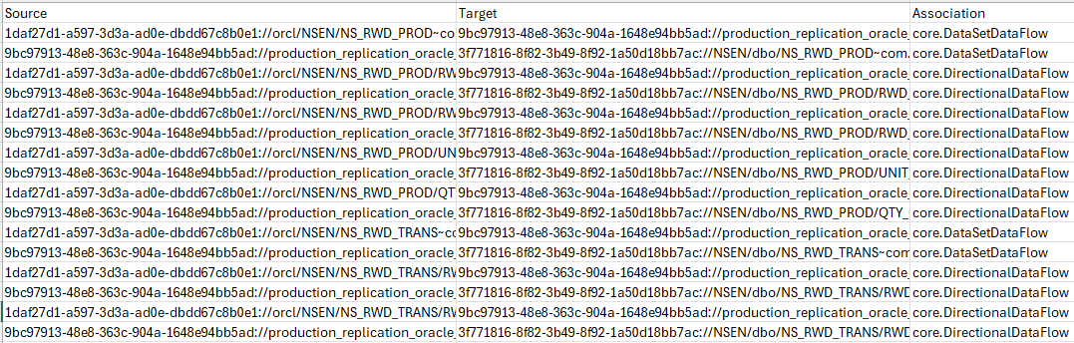
What are we trying to do?
If moving data from one source to another, want to be able to quickly create that custom lineage. CDGC now has some of this built in, but as of this writing, it only support relational sources, and does not allow fuzzy matching
Allow a config to sit out size the product (divorced from Ref ID’s) to communicate the sources and targets
Allow for Regex / wildcards if needed
Allow for fuzzy matching, and provide a threshold for when to match

Slide 3
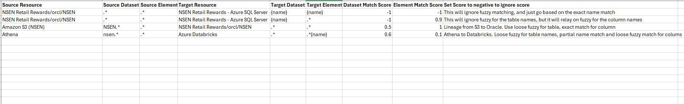
Configure with config.csv
Specify just the Resource name, or the Resource name and additional information, up to the “schema”
Specify just the Resource name, or the Resource name and additional information, up to the “schema”
Specify Fuzzy Matching minimum score for the Dataset / Element (for matching the sources to targets)
1.0 is a perfect match. 0.0 is no match at all
Setting to a negative number, means that it will ignore fuzzy matching altogether, and simply rely on the name matching
Setting to a number greater than 1 will disable the match completely
Source Dataset name, or a regex wildcard.
Same goes for the Elements
Specify the specific dataset / element name
OR name the name based on the source dataset / element
Use {name} or {s_dataset} or {s_element} as a token for the source name

Slide 4
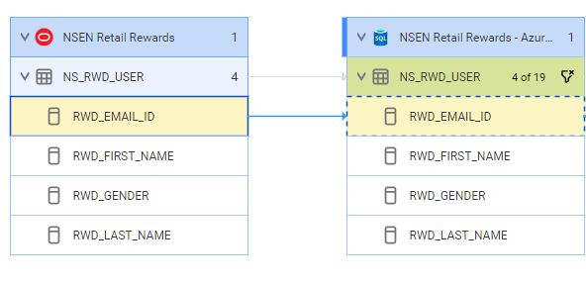
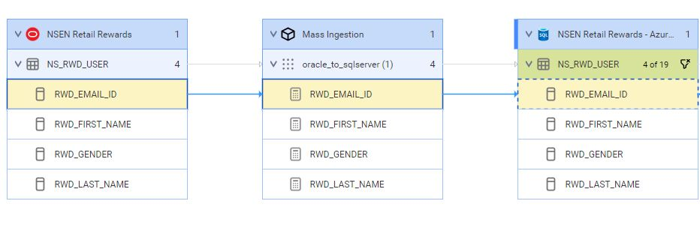
ETL Configuration (optional)
Optionally, you can configure the script to create custom sources to act an ETL to be between the source and target. The script will create a custom ETL source for you and build the lineage. For example:
Example of simple lineage:
Example of lineage with a custom ETL:

Slide 5
ETL Configuration (optional)
If including a custom ETL, add additional information in the config file:
ETL Resource Name. The Resource Name for the ETL.
ETL Path. Path that leads to the actual ETL logic separated by “/”. This might include projects, folders, etc.
ETL Path Types. The full class types for the above path separated by “/”.
ETL Dataset Type. The full class type for the “dataset” portion of the ETL. This will be the object included in lineage
ETL Dataset Name. The name for the “dataset” portion of the ETL. This will be the object included in lineage
ETL Element Type. The full class type for the “element” portion of the ETL. This will be the object included in lineage
ETL Element Name. The name for the “element” portion of the ETL.
Tokens:
{s_dataset}: Source Dataset
{t_dataset}: Target Dataset
{s_element}: Source Element
{t_element}: Target Element
{name}: Source dataset/element (context based)
Examples:

Slide 6
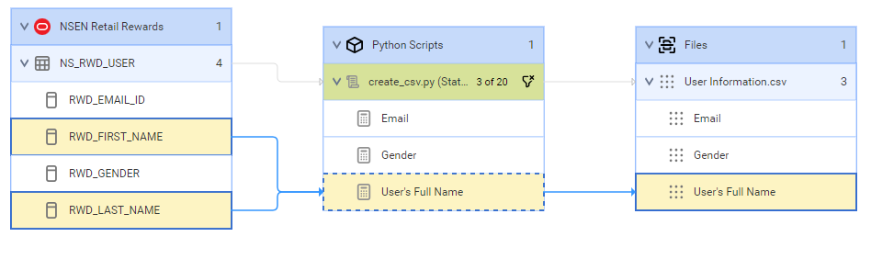
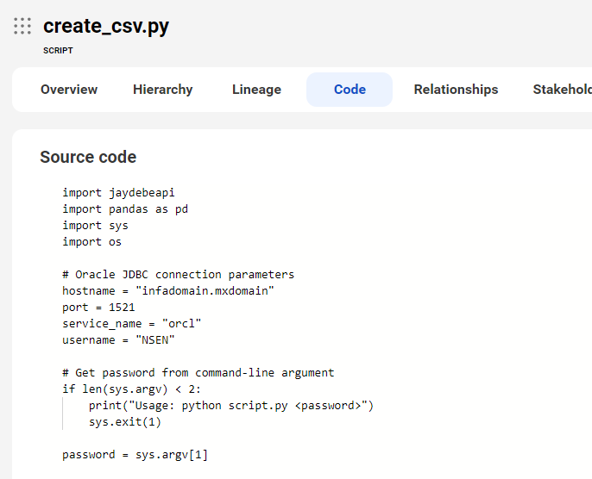
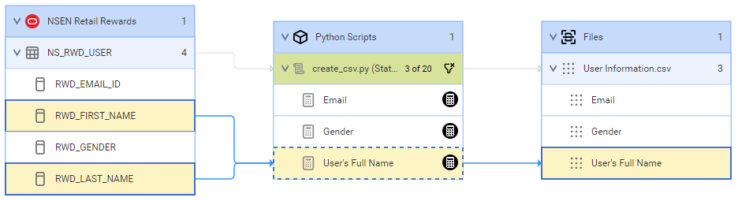
ETL Configuration (optional)
Optionally, you can configure the script to add additional attributes to the ETL custom sources. With that you can add descriptions, source code, calculations and more:
Example of lineage with a custom ETL (using the script model):
Example of custom script with source code:
Example of lineage with a custom ETL with attribute for expression (using the script model):

Slide 7
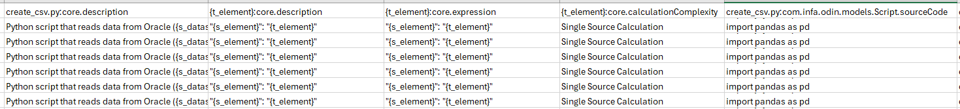
ETL Configuration (optional)
Extra Fields can be included, in case there are specific attributes you want to provide.
These object names, and values can contain tokens.
<object name>:<object attribute>. Value for the specified attribute
Examples:

Slide 8
Execution considerations
Things to note about the ETL :
If not provided, you will be prompted to choose a config file.
When the Lineage resource is created, it will use the config file name. for example
File “config - My Lineage.csv” will create “My Lineage” lineage resource
File “config_MyLineage.csv” will create “MyLineage” lineage resource
The script will execute the scans sequentially once it creates them

Slide 9
Usage
Things to note about the ETL :
(if first time running) Run pip to get the required libraries:
Execute the script (with or without optional parameters):
Windows exe file is also available, for environments where python is not available.
Optionally, you can create a credentials file in ~/.informatica_cdgc (c:\Users\<username\.informatica_cdgc for Windows). If it finds a default profile, it'll use it, otherwise it'll prompt for which profile to use. If you credential file exists, you will be prompted. Example credentials file:
pip install pandas datetime openpyxl Requests configparser requests_toolbelt
python custom_lineage_creator.py python3 custom_lineage_creator.py custom_lineage_creator.exe
[default1] pod = dmp-us user = shayes_example pwd = xyz [shayes_compass] pod = dmp-us user = shayes_compass pwd = abc [reinvent] pod = dm-us user = reinvent01 pwd = zyx

Slide 10
Usage (optional parameters)
Optionally, you can set parameters:
--help
Providing this parameter, will list all the options, and exit
--default_user
You can specify the username to use. if you do now specify one, it will look in the ~/.informatica_cdgc/credentials file (as shown below)
Example:
--default_user=shayes_compass
--default_pwd
You can specify the password to use. if you do now specify one, it will look in the ~/.informatica_cdgc/credentials file (as shown below)
Example:
--default_pwd=12345
--default_pod
You can specify the pod to use. if you do now specify one, it will look in the ~/.informatica_cdgc/credentials file (as shown below) Typically this "pod" can be shown in the url: for example: "dm-us"
Example:
--default_pwd=dm-us
--prompt_for_login_info
Is set to False, it will not prompt to confirm credentials, unless needed. So, if a [default] profile is set in credentials file, or if credentials provided on the command line, it won't prompt. This defaults to True
Example:
--prompt_for_login_info=False
--config_file
You can specify an exact config file to use. This csv file should exist in the same directory as the py or exe file that was executed.
Example:
--config_file="config - My Lineage.csv“
--config_file_path
You can specify an exact config file to use, including the full path. Similar to config_file setting, but you can specify a full path of the config file. For windows, use linux forward slashes.
Example:
--config_file_path="c:/junk/config - My Lineage.csv“
--pause_before_loading
You can force it to not pause, and just go ahead and load, if set to False this defaults to True
Example:
--pause_before_loading=False

Slide 11
Usage (optional parameters)
Optionally, you can set parameters:
--pause_when_done
You can set the behavior on whether or not the script pauses when it's complete. (So you can review the information on the window, before it disappears)
Example:
--pause_when_done=False
--use_api
You can set the script to not use the API. If you set this to False, then additional requirements will be needed. The script will not make any connection to your env, or use any APIs. For this reason, you'll need to
manually export the assets (Within Data Governance and Catalog perform a search for "resources" and export including children) Place the xlsx or zip file in the same location as the script/exe file. If using ETL, you’ll
also need to download the templates, and models that you'll be using. (Within Metadata Command Center, go to customize, metadata Models, then Download Template Models are json files, Metadata Templates are
zip files) place these files in the <script_location>/data/templates folder. If using this option, the script will not create resources or execute. So you'll need to manually create the resource(s) and execute them.
Example:
--use_api=False
--directory_with_assets_export
If you set the --use_api=False, you can specify which directory contains the export file zip/xlsx file It will default to the <script_location> and will look for the latest zip file or xlsx file in that directory.
Example:
--directory_with_assets_export=/my_files/assets
--directory_to_write_links_file
You can specify a different location to write the Lineage Resource zip files. It will default to <script_location>/links
Example:
--directory_to_write_links_file=/my_files/links
--directory_with_templates
You can specify a different location to reading/write the template and model files. It will default to <script_location>/data/templates
Example:
--directory_with_templates=/my_files/data/templates
--directory_to_write_resource_files
You can specify a different location to write the ETL Resource zip files. It will default to <script_location>/resources
Example:
--directory_to_write_resource_files=/my_files/resources
--extracts_folder
You can specify a different location to write the temporary files that the api downloads. These files are raw collection of resources, and assets (in the case of using the api) It will default to <script_location>/data
Example:
--extracts_folder=/my_files/data

Slide 12
Usage (optional parameters)
Optionally, you can set parameters:
--models_to_download
You can specify any additional models to download for your ETL. By default
it will download "com.infa.odin.models.IICS.V2","com.infa.odin.models.Script", and "core"
so no need to specify those. But if you are using an additional model, you can update the script
or you can specify the model in an array format. Note that typically, any templates you're going
to download, you'll want to get that model as well.
Example:
--models_to_download="['custom.etl', 'custom.myScript']"
--templates_to_download
You can specify any additional models to download for your ETL. By default
it will download "com.infa.odin.models.IICS.V2" and "com.infa.odin.models.Script"
so no need to specify those. But if you are using an additional model, you can update the script
or you can specify the model in an array format. Note that typically, any templates you're going
to download, you'll want to get that model as well.
Example:
--templates_to_download="['custom.etl', 'custom.myScript’]”
Examples running with command line options
python custom_lineage_creator.py --default_user=shayes_compass --default_pwd="my_password" --default_pod=dmp-us --prompt_for_login_info=False --config_file="config - Lineage (Oracle to SQL).csv" --pause_before_loading=False custom_lineage_creator.exe --default_user=shayes_test --default_pwd="my_password" --default_pod=dm-us --prompt_for_login_info=False --config_file="config - Lineage (Oracle to SQL).csv" --pause_before_loading=False

Slide 13
Output
Python will prompt for which config file to use (if config file not specified)
Python will look for the config.csv in the same directory (if config file not specified)
Will display the lineage that it’s creating along with any fuzzy matching score
Will write the lineage files in the “links” directory
Will write the resources files in the “resources” directory
Will write some raw temporary data in the “data” directory.
Select a CSV file: 1. config - Lineage (with ETL).csv - Lineage (with ETL) 2. config - Lineage with Mass Ingestion.csv - Lineage with Mass Ingestion Enter the number of the file to select (1-2): 1 INFO: Downloading initial data INFO: No 'default' profile found. Please select a profile: 1. Test 2. shayes_compass 3. reinvent Enter the number of the profile to use: 1 Using credentials from the 'Test' profile. Enter pod (default: dmp-us): Enter username (default : shayes_test): Enter password: Successfully written Mass Ingestion to C:\Toolbox\Python\Projects\Custom_Lineage_Creator\Test2/resources/Mass Ingestion_20241122171323.zip Test v1/orcl/TEST/INFORMATICA_TEST_DEIDENTIFICAT -> Mass Ingestion/Pro...AT/oracle_to_sqlserver_INFORMATICA_TEST_DEIDENTIFICAT (1) (1.0) Mass Ingestion/Pro...AT/oracle_to_sqlserver_INFORMATICA_TEST_DEIDENTIFICAT (1) -> Test v2/orcl/TEST/INFORMATICA_TEST_DEIDENTIFICAT (1.0) Test v1/orcl/TEST/INFORMATICA_TEST_DEIDENTIFICAT/NAME1 -> Mass Ingestion/Pro...AT/oracle_to_sqlserver_INFORMATICA_TEST_DEIDENTIFICAT (1)/sync_NAME1 (1.0) Mass Ingestion/Pro...AT/oracle_to_sqlserver_INFORMATICA_TEST_DEIDENTIFICAT (1)/sync_NAME1 -> Test v2/orcl/TEST/INFORMATICA_TEST_DEIDENTIFICAT/NAME1 (1.0) Test v1/orcl/TEST/INFORMATICA_TEST_DEIDENTIFICAT/NAME2 -> Mass Ingestion/Pro...AT/oracle_to_sqlserver_INFORMATICA_TEST_DEIDENTIFICAT (1)/sync_NAME2 (1.0) Mass Ingestion/Pro...AT/oracle_to_sqlserver_INFORMATICA_TEST_DEIDENTIFICAT (1)/sync_NAME2 -> Test v2/orcl/TEST/INFORMATICA_TEST_DEIDENTIFICAT/NAME2 (1.0) Writing to C:\Toolbox\Python\Projects\Custom_Lineage_Creator\Test2/links\Lineage (with ETL)_20241122171323.zip containing links.csv INFO: Preparing to create/update "Mass Ingestion" using "C:\Toolbox\Python\Projects\Custom_Lineage_Creator\Test2/resources/Mass Ingestion_20241122171323.zip" INFO: Preparing to create/update "Lineage (with ETL)" using "C:\Toolbox\Python\Projects\Custom_Lineage_Creator\Test2/links\Lineage (with ETL)_20241122171323.zip" Press the <ENTER> key create resources... INFO: Successfully updated resource "Mass Ingestion" INFO: Successfully created resource "Lineage (with ETL)" INFO: Successfully started scan job for "Mass Ingestion" STARTING............... RUNNING........................ COMPLETED INFO: Successfully started scan job for "Lineage (with ETL)" STARTING............... RUNNING........................ COMPLETED

Slide 14
Thank You
Questions / Issues / Suggestions:
Scott Hayes
shayes@informatica.com

